Slide 1

Challenges? We got challenges!!!
Len Seligman

Slide 2
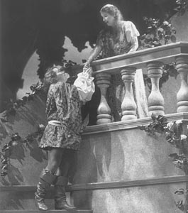
First…
The Geek-Tones thank our devoted fans!
MP3 and slide show for “What a Wonderful World (DB version)” will be at lenandwendy.com/geektones

Slide 3
There are giant information management problems all around us!

Slide 4
Example: Counter-Terrorism
Vast numbers of sources
Rapid integration and mining of new sources
While protecting security and privacy
Evolution

Slide 5


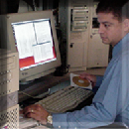
Mega-Enterprise Challenges
Consumer:
Do I understand what this data means?
Should I trust it?
  Where did it come from?
  Is it too old?
I want only the most important data for my current task? (Seligman et al, JIIS, 2000)
Producer:
Will my data fall into the wrong hands?
Developer:
A new source is available. How do I rapidly incorporate it?
Will I be notified of changes to sources? How will I have to change my app?
Out of the thousands of schemas already out there, do any partially meet my needs? If I reuse, will it simplify my life?
Policy Setters:
Can I easily express sharing policy? Am I confident it will be enforced? With what consequences?
Notes:
Our earlier briefing focused on data challenges for NCW. We started with these data concerns, then described a set of hard problems, and recommended tasks.

Slide 6
Managing semantics
Not obscure AI, real organizations need to do this and they don’t know how
See current SIGMOD Record for war stories, guidelines, and research issues
  Rosenthal, Seligman, Renner, “Semantics Management: Case Studies and a Way Forward”

Slide 7
DoD War Stories
Global standards (~1993-2000)
  12,000 “standard” data elements, most not used in any system
  Metrics emphasized capture, not exploitation
  Result: Millions spent, few interoperability benefits
Lessons:
  Standards must have reasonable scope
    Communities of interest (COIs)
  Exploitation, not just capture!
New approach: “DoD Net-Centric Data Strategy”
  Publish COI schemas, ontologies in a metadata registry so they can be discovered, mediated

Slide 8
DoD Net-Centric Data Strategy
Shared Infospace
Producers
Post
Discovery
Consumers
Metadata
Advertise
3
Developers
O(10 ) schemas
Mediation
5
O(10 ) element defs
Gobs of mappings

Slide 9

Challenge Application: Bio-Terrorism
Data Mining
Data Integration System
Hospi-tals
CDC
Insur-ance
Dr.
Offices
School
Attend-ance
Pharma
Purchase

